Slide 1

Executive Sales Performance Overview
Summary of key sales metrics and business achievements for Bright Coffee Shop Chief Executive Officer
Notes:
AI-generated content may be incorrect. ---

Slide 2
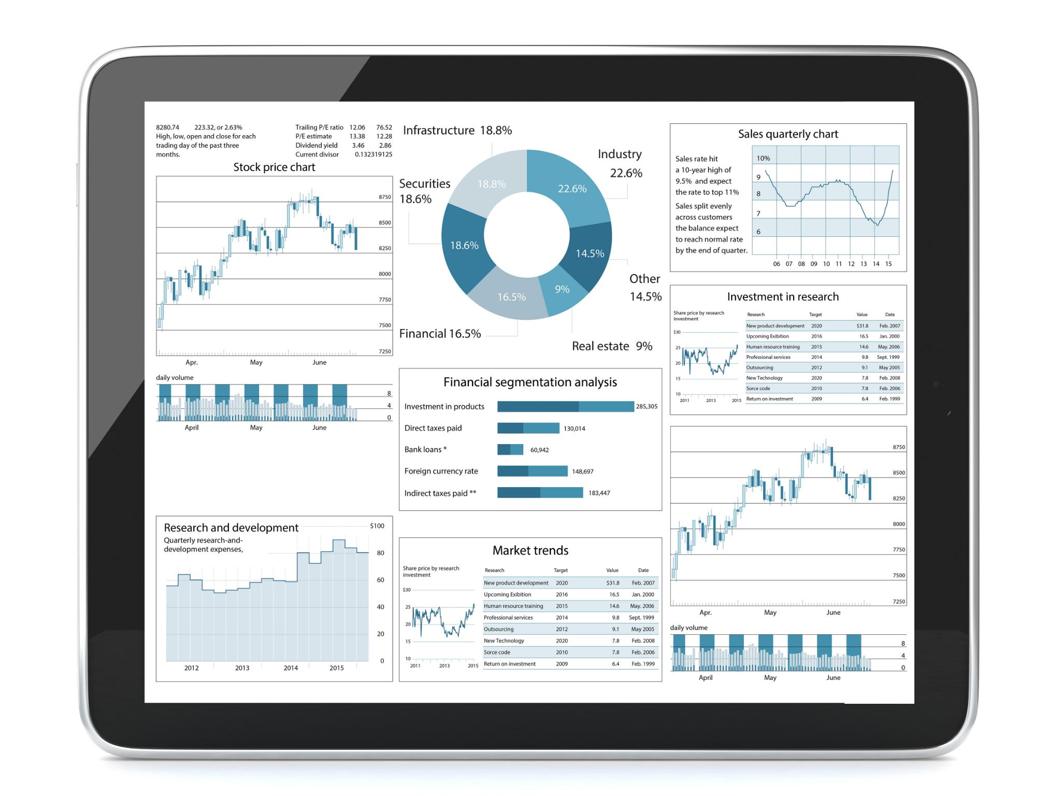
Executive Overview
Sales Performance Summary
High-level overview of sales across products and stores highlights revenue drivers and inefficiencies.
Peak Demand Periods
Sales peak during specific time windows, indicating opportunities for staffing and promotions optimization.
Product Category Insights
Beverages like Coffee and Tea lead sales, with Bakery and Drinking Chocolate as important supporting products.
Localized Store Variations
Each store shows unique demand patterns, emphasizing the need for tailored local strategies.
Notes:
This executive overview provides a concise, high-level summary of overall sales performance across products, store locations, and time-of-day trading patterns. The objective is to highlight where the business is performing well, where inefficiencies or missed opportunities may exist, and how demand fluctuates throughout the trading day. The analysis consolidates transactional data into simple, CEO-ready insights that focus on strategic signals rather than operational detail. Overall results indicate that beverages, particularly Coffee and Tea, are the primary revenue drivers, while Bakery and Drinking Chocolate play a supporting but strategically important role. Sales concentration is strongest during specific time intervals, suggesting clear peak demand windows that can be better leveraged through staffing, promotions, and product mix adjustments. Each store exhibits slightly different demand characteristics, reinforcing the importance of localized decision-making. This presentation is designed for clarity and speed of understanding, using consistent color coding across visuals to maintain alignment with the original charts. The goal is to support executive decision-making around revenue growth, operational efficiency, and targeted intervention to improve underperforming periods without increasing unnecessary complexity.

Slide 3
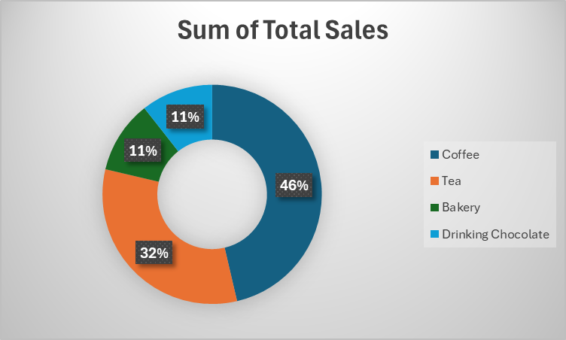
Total Sales by Product Category
Product Category | Total Sales
Coffee | 2037.5
Tea | 1421.7
Bakery | 471.0
Drinking Chocolate | 466.0
Grand Total | 4396.2
Notes:
Total sales by product category clearly show that Coffee is the dominant contributor to overall revenue, followed closely by Tea. Together, these two beverage categories account for the majority of transactional value and volume, confirming that the business is strongly beverage-led. Bakery and Drinking Chocolate generate lower total sales, yet they remain important for margin enhancement, customer experience, and cross-selling opportunities. The sales distribution suggests that strategic focus should remain on optimizing Coffee and Tea availability, quality, and promotion, while selectively growing complementary items. From an executive perspective, this indicates a relatively healthy product mix with identifiable growth levers. Expanding high-margin variants, bundling bakery items with beverages, or promoting Drinking Chocolate during colder or evening periods may improve contribution without diluting focus. Understanding these category-level dynamics allows leadership to prioritize investment, marketing attention, and operational support toward the products that move the revenue needle most significantly.

Slide 4
Sales by Store Location
Balanced Store Contributions
Astoria, Hell’s Kitchen, and Lower Manhattan all contribute meaningfully without one dominating revenue.
Beverage Sales in Hell’s Kitchen
Hell’s Kitchen leads slightly in beverage sales due to consistent demand throughout the day.
Early-Day Trading in Lower Manhattan
Lower Manhattan shows strong early-day sales driven by commuters valuing speed and convenience.
Tailored Store Strategies
Store-specific promotions and staffing optimize performance based on unique demand patterns.
Notes:
Sales analysis by store location shows that Astoria, Hell’s Kitchen, and Lower Manhattan all contribute meaningfully to overall performance, with no single store overwhelmingly dominating revenue. Hell’s Kitchen shows a slight edge in overall beverage sales, reflecting strong, consistent demand throughout the day. Lower Manhattan is distinguished by particularly strong early-day trading, indicating a commuter-driven customer base that values speed and accessibility. Astoria demonstrates balanced performance with notable strengths in selected product categories and time intervals. From a leadership standpoint, these patterns reinforce that performance improvement should not rely on a one-size-fits-all approach. Instead, store-specific tactics such as tailored promotions, localized staffing strategies, and adjusted product emphasis can unlock additional growth. The relatively even performance across stores also suggests operational resilience, while still leaving room for optimization based on identifiable demand behaviors.

Slide 5
Overall Sales by Time of Day
Notes:
When sales are viewed by time of day across all stores and products, a clear pattern emerges. Afternoon trading is the strongest revenue period, significantly outperforming Morning and Evening intervals. Late Morning follows as the second-best performing window, while Night consistently records the lowest sales volumes. This concentration of demand suggests that customer traffic and spending behavior are highly time-sensitive. For executive decision-making, this highlights a strong opportunity to double down on peak periods through optimal staffing, faster service, and targeted upselling. Conversely, underperforming periods such as Night represent potential growth opportunities if approached strategically, rather than viewed purely as low-demand times. Adjusting operating models, promotional activity, or product offerings by time of day could improve overall sales efficiency without necessarily extending operating hours or increasing fixed costs.

Slide 6

Coffee Performance Insights
Sales Peaks Timing
Coffee sales peak consistently in the Afternoon and perform well in the Late Morning across all locations.
Early Morning Demand
Lower Manhattan shows strong Early Morning coffee sales driven by commuters and weekday routines.
Evening Sales Drop
Coffee sales decline noticeably in Evening and Night periods, especially outside Astoria.
Strategic Focus
Focus on optimizing timing and premium offerings rather than expanding coffee categories to enhance revenue.
Notes:
Coffee performance analysis shows a strong and predictable demand curve across all three store locations. Sales peak most consistently in the Afternoon, with Late Morning also performing well. Lower Manhattan stands out for its strong Early Morning coffee sales, likely driven by commuter behavior and weekday routines. Evening and Night periods show a noticeable drop-off, particularly outside of Astoria. From an executive lens, Coffee represents both a stable revenue anchor and a prime lever foroptimization. Enhancing premium offerings, improving throughput during peak Afternoon periods, and experimenting with limited-time offers in the Evening could extend sales without compromising brand positioning. The data confirms that Coffee should remain the centerpiece of operational and commercial strategy, with refinements focused on timing rather than category expansion.

Slide 7
Tea Performance Insights
Demand Patterns
Tea demand peaks during Late Morning and Afternoon, with sales dropping sharply at night, especially in Lower Manhattan.
Complementary Role
Tea benefits from complementing Coffee sales rather than independently driving traffic across stores.
Strategic Growth Opportunities
Bundled offers and targeted Afternoon promotions can boost Tea sales and increase average transaction value.
Notes:
Tea follows a similar but slightly softer demand pattern compared to Coffee. Afternoon and Late Morning remain the strongest time intervals, with relatively balanced performance across stores. Night sales decline more sharply, especially in Lower Manhattan. Tea’s consistent but less dominant performance suggests that it benefits from complementing Coffee-led demand rather than driving traffic independently. For senior leadership, this indicates an opportunity to strengthen Tea sales through pairing strategies, such as bundled offers with light bakery items or targeted Afternoon promotions. Additionally, highlighting premium or specialty Tea options during peak periods could incrementally lift average transaction value. Tea remains a dependable contributor, but one that responds best to strategic positioning rather than aggressive expansion.

Slide 8

Bakery & Drinking Chocolate Insights
Time-of-Day Sales Sensitivity
Bakery sales peak in the evening, especially in Astoria and Lower Manhattan, reflecting discretionary snack behavior.
Drinking Chocolate Night Strength
Drinking Chocolate performs strongly at night in Astoria, outperforming other locations during late hours.
Targeted Production and Promotion
Align bakery production with evening demand and promote Drinking Chocolate during cold or late periods to reduce waste.
Strategic Product Management
Manage these items as margin enhancers and experience differentiators, not as core volume drivers.
Notes:
Bakery and Drinking Chocolate display more pronounced time-of-day sensitivity than beverages. Bakery sales peak in the Evening, particularly in Astoria and Lower Manhattan, indicating a stronger snack or discretionary purchase behavior later in the day. Drinking Chocolate shows a unique strength in Astoria at Night, outperforming other stores during that interval. These patterns suggest that these categories are opportunity-driven rather than volume-driven. From an executive perspective, targeted activation is key. Aligning bakery production with Evening demand and selectively promoting Drinking Chocolate during colder or late hours could enhance contribution without increasing waste. These products should be managed tactically as margin enhancers and experience differentiators rather than core volume drivers.

Slide 9
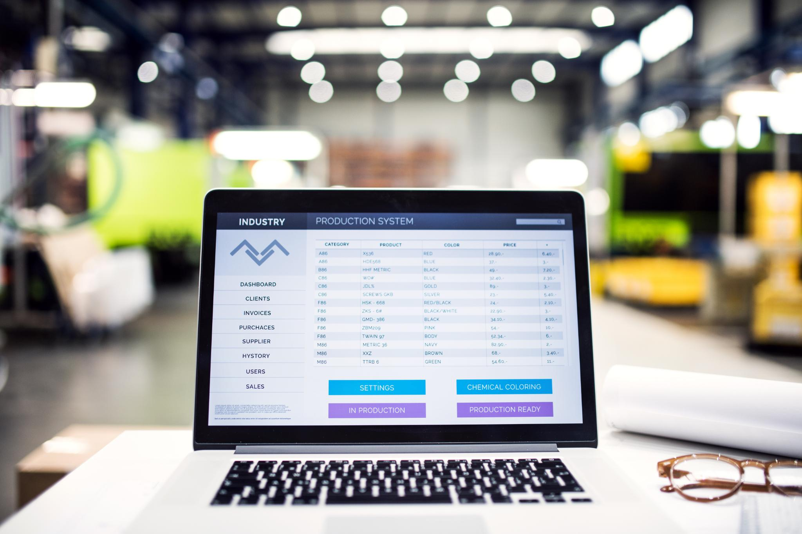
Key Strategic Observations
Critical Afternoon Revenue
Afternoon represents the key revenue window requiring focused operational and commercial protection.
Time-Dependent Performance
Product performance varies with time, emphasizing the need for time-based decision-making.
Localized Store Optimization
Distinct demand profiles necessitate store-level customization over centralized approaches.
Opportunities in Underperformance
Underperforming periods like Night offer chances for controlled experimentation and growth.
Notes:
Several clear strategic observations emerge from the consolidated analysis. First, Afternoon is the most critical revenue window and should be protected operationally and commercially. Second, product performance is highly time-dependent, reinforcing the importance of time-based decision-making. Third, stores exhibit distinct demand profiles, justifying localized optimization rather than centralized uniformity. Finally, underperforming periods such as Night are not failures but opportunities for controlled experimentation. These insights suggest that the business is fundamentally healthy, with growth more likely to come from smarter utilization of existing demand rather than aggressive expansion. For leadership, this reinforces the value of precision over scale in driving future performance improvements.

Slide 10
Actions to Improve Sales Performance
Optimize Peak Hour Staffing
Prioritize staffing, speed, and product availability during afternoon peak hours to capture maximum demand.
Target Evening Promotions
Introduce targeted promotions for bakery and drinking chocolate in evening and night to boost weaker periods.
Store-Specific Strategies
Tailor sales strategies by store, leveraging strengths of different locations at various times of day.
Increase Transaction Value
Use bundling and cross-selling, pairing beverages with bakery items to increase average transaction value.
Continuous Performance Monitoring
Monitor sales performance continuously by time and store to enable rapid adjustments and sustained growth.
Notes:
To improve sales performance, several focused actions are recommended. First, prioritize staffing, speed, and product availability during Afternoon peak hours to fully capture demand. Second, introduce targeted Evening and Night promotions, particularly for Bakery and Drinking Chocolate, to lift weaker periods without cannibalizing peak sales. Third, tailor strategies by store, leveraging Lower Manhattan’s Morning strength and Astoria’s Evening and Night opportunities. Fourth, use bundling and cross-selling to increase average transaction value, especially pairing beverages with bakery items. Finally, continuously monitor performance at a time-of-day and store level to ensure rapid adjustment. These actions emphasize disciplined execution over complexity and are designed to drive measurable, sustainable revenue growth.

